Slide 2



Bye, ASP.NET Web Forms! Welcome, Blazor!
Justin Yoo | Microsoft
@justinchronicle
@justinyoo

Slide 3
Demo – ASP.NET Web Forms

Slide 4




Web Forms
front-end
back-end
Notes:
Here’s basic application architecture
We’re building a Blazor web application to summarise a YouTube video using Azure OpenAI Service
First of all we get the subtitle from a given YouTube video link, then ask Azure OpenAI Service to summarise it
OK. Are you ready? Let’s do it

Slide 5
Why staying in ASP.NET Web Forms?

Slide 6
Mature enough

Slide 7
Mature enough
Rich controls

Slide 8
Mature enough
Rich controls
Similar developer experience as WinForm

Slide 9
Why moving away from ASP.NET Web Forms?

Slide 10
Windows only

Slide 11
Windows only
No .NET 8 support

Slide 12
Windows only
No .NET 8 support
No built-in async event-handling
Notes:
Modern libraries async support only

Slide 13
Windows only
No .NET 8 support
No built-in async event-handling
No built-in dependency management
Notes:
3rd party library – less enterprisy

Slide 14
Windows only
No .NET 8 support
No built-in async event-handling
No built-in dependency management
Maintenance overhead

Slide 15
Available alternatives?

Slide 16
ASP.NET MVC

Slide 17

ASP.NET MVC

Slide 18
Angular, React, Vue, etc

Slide 19
Angular, React, Vue, etc

Slide 20
Blazor

Slide 21

Blazor

Slide 22
Why migrate to Blazor?

Slide 23
Similar component model
Notes:
Similarities

Slide 24
Web Forms
Blazor
.aspx page control
.ascx user control
.razor component

Slide 25
Similar component model
Similar page lifecycle management

Slide 26
Web Forms
Blazor
Page_Init
Page_Load
Page_Render
SetParameters{Async}
OnInitialized{Async}
OnParametersSet{Async}
OnAfterRender{Async}

Slide 27
Improved data binding
Notes:
Benefits

Slide 28
Web Forms
<asp:TextBox runat=“server” ID=“MyTextBox” … />
Blazor
<input type=“text” … @bind=“MyText” />

Slide 29
Improved data binding
Improved event handling
C# for both front-end / back-end

Slide 30
Web Forms
<asp:Button … OnClick=“Button_Click” />
Blazor
<button … @onclick=“ButtonClickedAsync”></button>

Slide 31
Improved data binding
Improved event handling
C# for both front-end / back-end

Slide 32
Blazor
<button … @onclick=“ButtonClickedAsync”></button>
@code {
protected async Task ButtonClickedAsync()
{
…
}
}

Slide 33
Improved event-handling
Improved data binding
C# for both front-end / back-end
JavaScript interoperability

Slide 34
Blazor
@inject IJSRuntime JSR
<button … @onclick=“ButtonClickedAsync”></button>
@code {
protected async Task ButtonClickedAsync()
{
await JSR.InvokeVoidAsync(“MyJSFunction”);
}
}

Slide 35
How to migrate to Blazor?

Slide 36
Move business logic to class libraries
Notes:
This will be one of the hardest parts because legacy code might get the UI logic mixed with business logic
Need a lot of refactoring
Use .NET Standard libraries
After the separation, reference them back to the Web Forms project so that you’ve separated properly

Slide 37
Move business logic to class libraries
Choose Blazor hosting model
Notes:
Server mode – known as Blazor Server
Client mode – known as Blazor Web Assembly
Streaming mode – known as SSR (server-side rendering)

Slide 38
Reference class libraries

Slide 39
Reference class libraries
Migrate static files – HTML, JS, CSS, images

Slide 40
Reference class libraries
Migrate static files – HTML, JS, CSS, images
Migrate Web.config to appsettings.json

Slide 41
Reference class libraries
Migrate static files – HTML, JS, CSS, images
Migrate Web.config to appsettings.json
Migrate global.asax to Program.cs

Slide 42
Rewrite .aspx/.ascx to .razor

Slide 43
Rewrite .aspx/.ascx to .razor
Data binding

Slide 44
Rewrite .aspx/.ascx to .razor
Data binding
Event handling

Slide 45
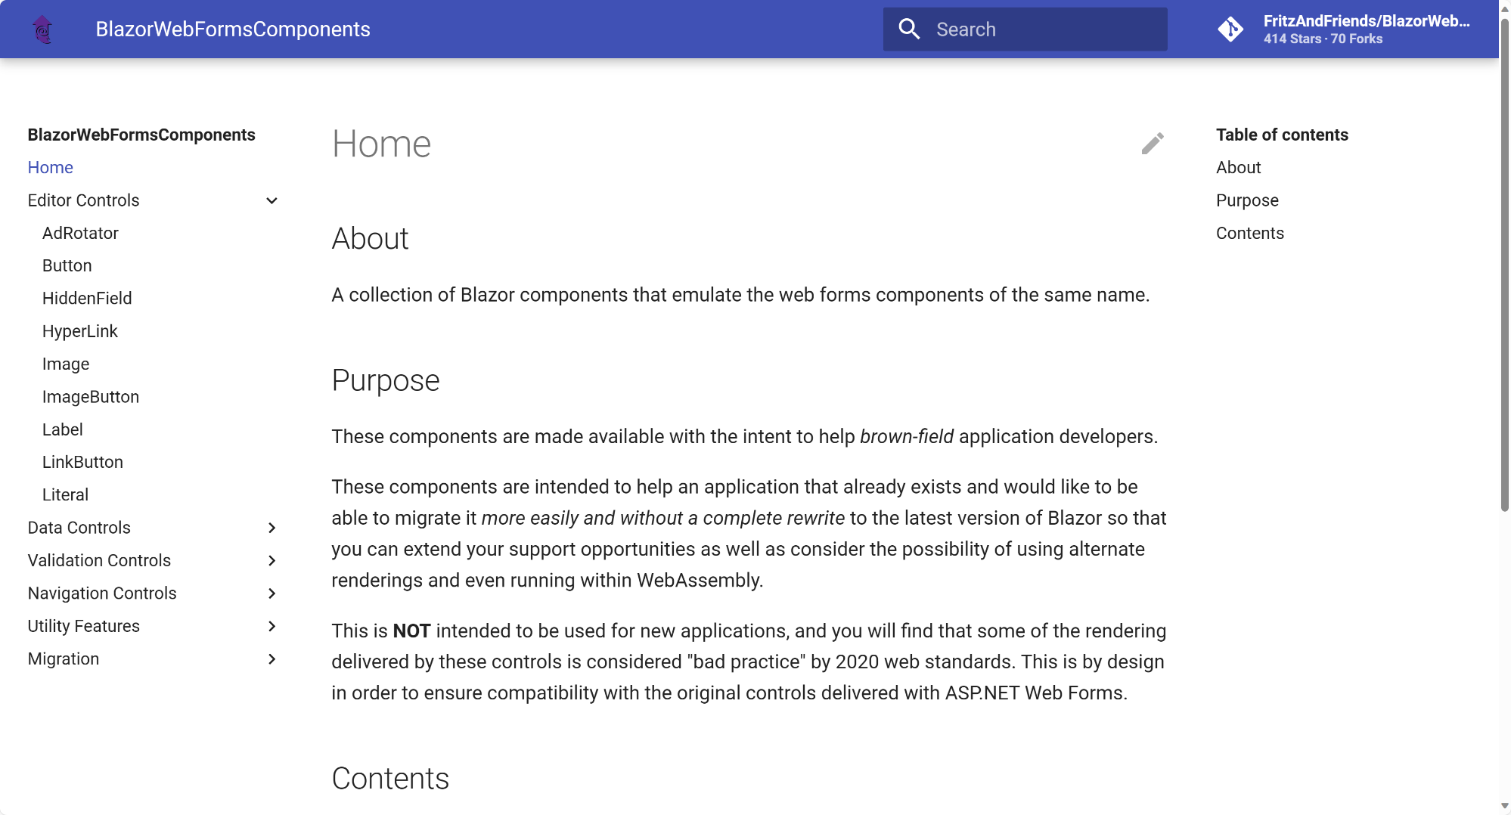
https://aka.ms/blazor-webforms-components

Slide 46
Demo – Blazor Web App

Slide 47
Web Forms
front-end
back-end
Notes:
Here’s basic application architecture
We’re building a Blazor web application to summarise a YouTube video using Azure OpenAI Service
First of all we get the subtitle from a given YouTube video link, then ask Azure OpenAI Service to summarise it
OK. Are you ready? Let’s do it

Slide 48

front-end
back-end
Notes:
Here’s basic application architecture
We’re building a Blazor web application to summarise a YouTube video using Azure OpenAI Service
First of all we get the subtitle from a given YouTube video link, then ask Azure OpenAI Service to summarise it
OK. Are you ready? Let’s do it

Slide 49
JavaScript Interop

Slide 50
Calling JavaScript functions from C#
Calling C# methods from JavaScript

Slide 51
To integrate existing JS UI components

Slide 52
Demo – JavaScript Interop

Slide 53
Summary

Slide 54
Why migrate ASP.NET Web Forms to Blazor

Slide 55
Why migrate ASP.NET Web Forms to Blazor
Benefits of migration to Blazor

Slide 56
Why migrate ASP.NET Web Forms to Blazor
Benefits of migration to Blazor
Migration process

Slide 57
Why migrate ASP.NET Web Forms to Blazor
Benefits of migration to Blazor
Migration process
JS Interop for existing JS library integration

Slide 58

Resources
Download .NET 8 aka.ms/get-dotnet-8
YouTube Summariser aka.ms/youtube-summariser
Blazor WebForms Components aka.ms/blazor-webforms-components
Fluent UI Blazor Fluent UI aka.ms/fluentui aka.ms/fluentui/blazor

Slide 59
Download .NET 8
https://aka.ms/get-dotnet-8

Slide 60
Thank you!

